Slide 1
Credit Card Fraud Detection
Capstone Project
Ruchika Sheshkar
Vasvi Bhangalia
Yash Bhatt

Slide 2
Agenda
Introduction: Problem Definition
What and Why
How - Process that we followed
Root Cause Analysis of Problem
Model Output and Performance
Finding and Insights with Visualization
Business Impact
Recommendations

Slide 3
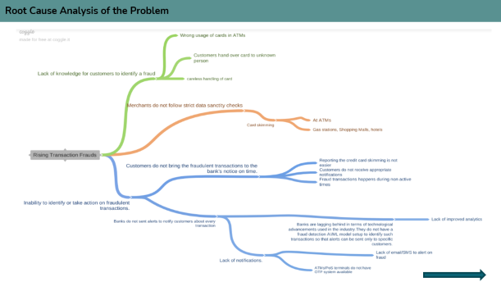
Problem Statement
Customers are using online and offline banking very frequently these days. Number of fraud transactions has also increased drastically due to which credit card companies are facing a lot of challenges.
To detect the fraudulent activities and to get profit by not losing the customers information is the main goal for the Bank. Also to retain the more profitable customers by detecting and stopping the fraudulent activities.
So, We need to classify the fraudulent credit card transactions to avoid the losses.

Slide 4
Solution Approach - Steps which gets you closer to the goal
Analysis of Problem
- Analysing the problem through 5W and 1H
- Collecting the data
- Understanding and Cleaning the data gain insights which helps in further process of data analysis
Data Understanding
-Univariate
-Bivariate
-Multivariate analysis
Exploratory Data Analysis
- Creating derived features
- VIF, Feature Importance, RFE, etc.
Feature Engineering and Selection
- Handling data imbalance using techniques like SMOTE
- Train and test the models with different algorithm (Random Forest, Decision Trees, etc.,)
Model Building
Assessing the model with the help of different techniques like confusion matrix, Accuracy, Precision, Recal, ROC/AUC curve, etc.
Model Evaluation

Slide 5
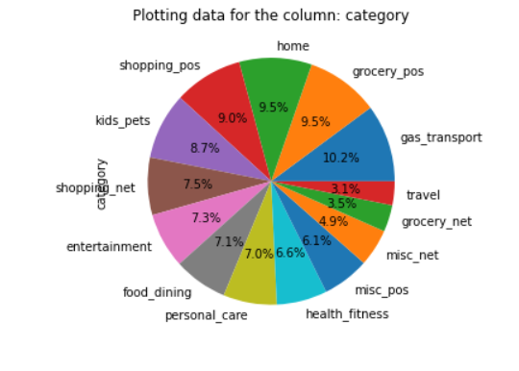
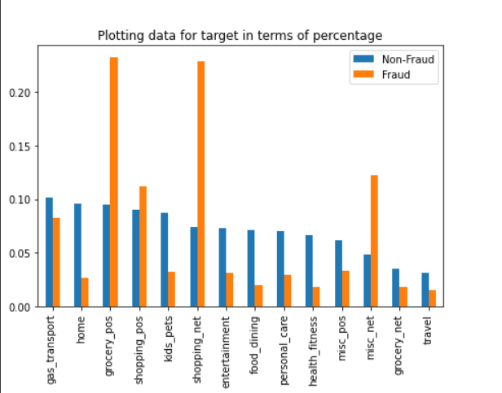
Key Insights : ~45% of the fraudulent transactions are happening from combined Grocery and Shopping sales category
shopping-net
Findings and Insights
Above 20% fraudulent transactions are happening through both Grocery and Shopping category
These two categories are having more number of fraudulent transaction than normal transactions

Slide 6
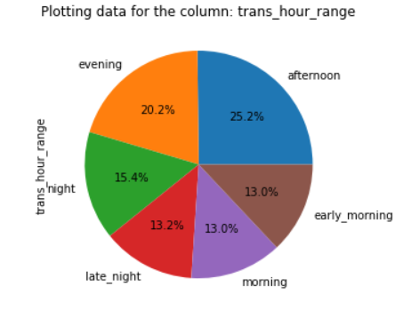
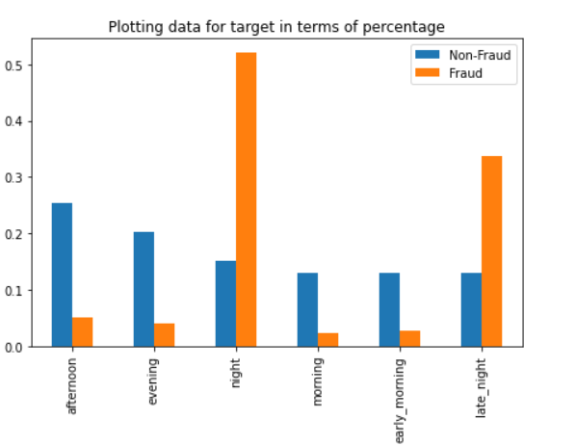
Key Insights : ~52% of the fraud transactions are happening in Night time
Findings and Insights
Combined 46% of transactions are happening in Afternoon and Evening time of the day followed by 15% of Night time
Less than 5% of the fraud transactions are occurring in Morning time
More than 80% transaction happening at Night and Late night are fraudulent transactions

Slide 7
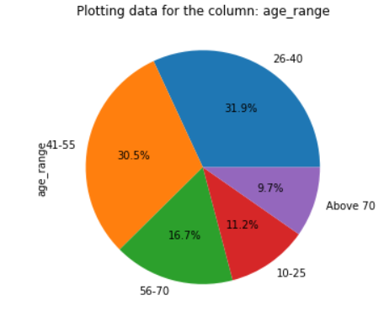
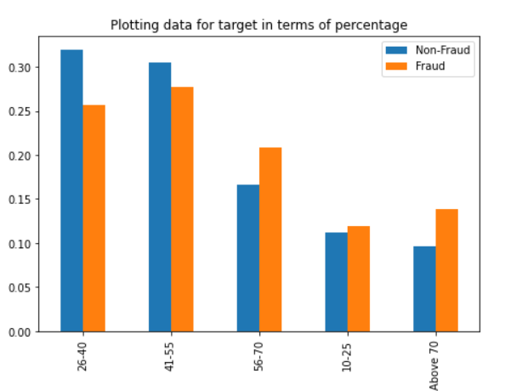
Key Insights : More than 50% of the fraud transactions are done by credit card holders from 26-55 Age group
Findings and Insights
~63% of the credit card transactions are being done by credit card holder who belong to 26-40 and 41-55 Age group.
28% and 26% of the fraudulent transactions belong to 26-55 Age people
The percentage of fraudulent transactions seems to be more than Non-Fraud transactions for 10-25 and above 56 Age group people

Slide 8
Cost Benefit Analysis : Before Model
Current Losses
Average number of transactions happening per month
77,183
Average number of fraudulent transactions per month
417
Average amount per fraudulent transaction
$ 503
Total cost incurred per month
$ 221,427

Slide 9
Business Impact: The benefits and final saving after the classification model usage
430 are the average number of transactions per month detected as fraudulent by the model
$645 is the Total cost of providing customer support per month for fraudulent transactions detected by the model (430*$1.5)
Average transactions per month that are fraudulent but not detected by the model is 82
$43,542 is the Cost incurred due to fraudulent transactions left undetected by the model
Cost incurred per month after the model is built and deployed $44,187
We can save ~80% of the current cost incurred which is $177,240 as the final savings

Slide 10
Final Recommendations :
After Model building the final savings is going to be ~80% , which can be achieved with the help of this model along with below recommendations:
Need to focus more on Credit card transactions that are happening during Night
We can focus more on the transactions that are happening from Grocery and Shopping category, as 20% fraud transactions are happening through them.
The time interval between transaction is observed to be 50% lesser in fraudulent transactions than in Non-fraud transactions. Need to focus on time interval between transactions to identify the fraud.

Slide 11
Appendix

Slide 12
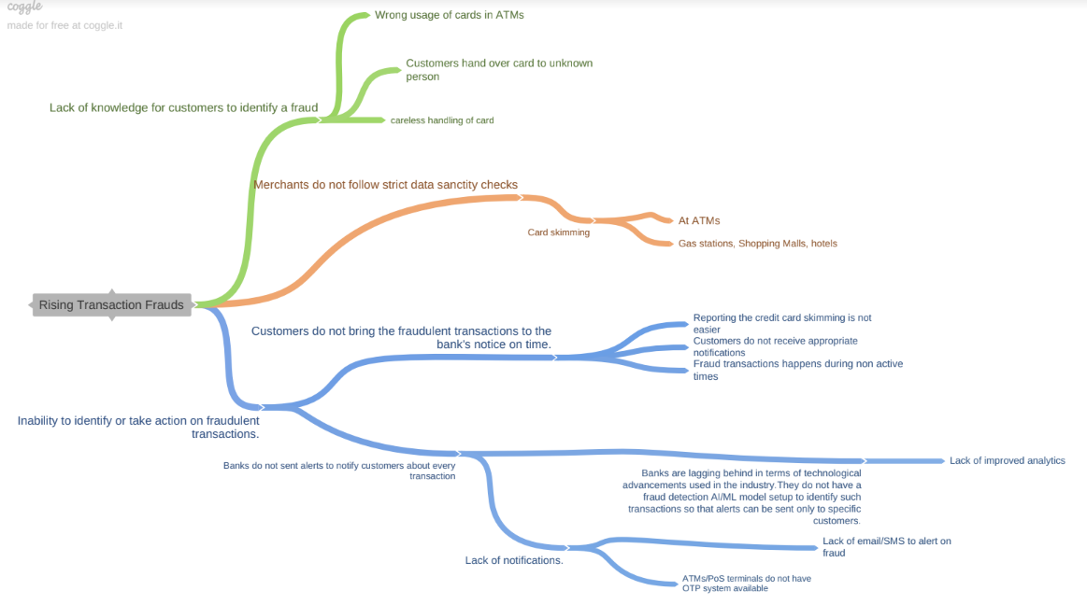
Root Cause Analysis of the Problem

Slide 13
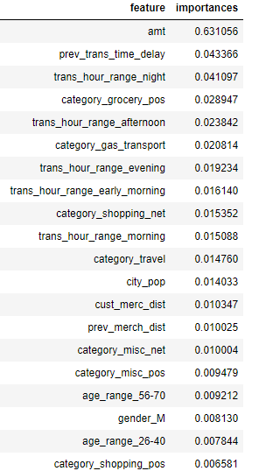
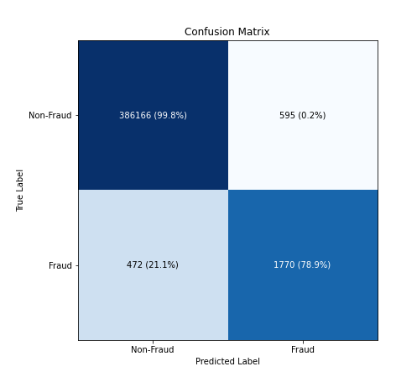
Methodology Overview and Model Output
Data Imbalance Techniques
SMOTE
ADASYN
Feature Importance
Final Model Output
Hyperparameter Tuning
Random Search CV
Model Selected:
Random Forest Classifier
Model Evaluation
ROC / AUC curve
Precision
Recall
ML Models
Random Forest Classifier
XGBOOST
Decision Tree Classifier

Slide 14
Thank You!

